Slide 1
Vertical
Farming
By: Carson Dickson and Emmaline Meadows

Slide 2
Overview:
History
Plan and Implementation
Pros
Cons
Summary
References

Slide 3
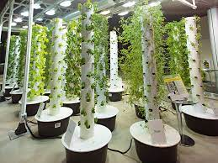
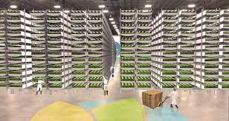
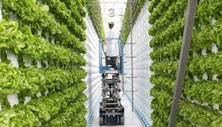
Examples of vertical farming

Slide 4
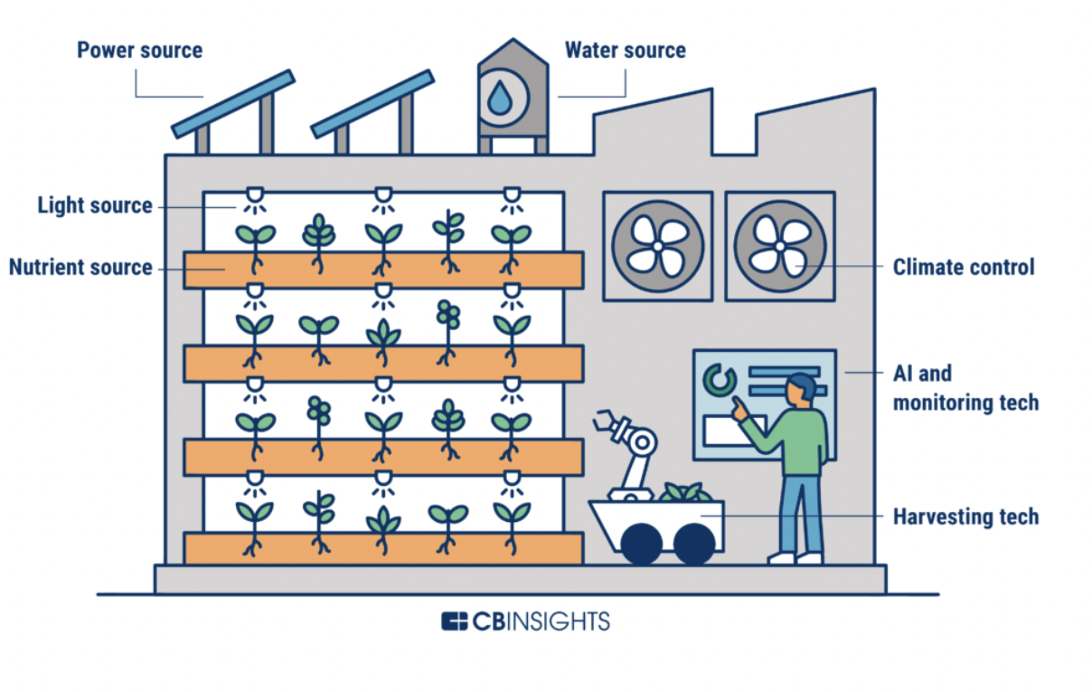
History
The concept of vertical farming was discovered in 1999 by Dickson Despommier.
They then designed a 30-story farm full of these Vertical Farms to help plantation and could be able to feed around 50,000 people.
From there, the plan grew and became a smart, popular way to be more efficient for growing plants
Notes:
Dickson was a professor of Public and Environmental Health and Vertical Farming was discovered when he challenged his students to calculate how much food they could grow on a rooftop. He told them to stack them vertically so there can be more plants in one spot.

Slide 5
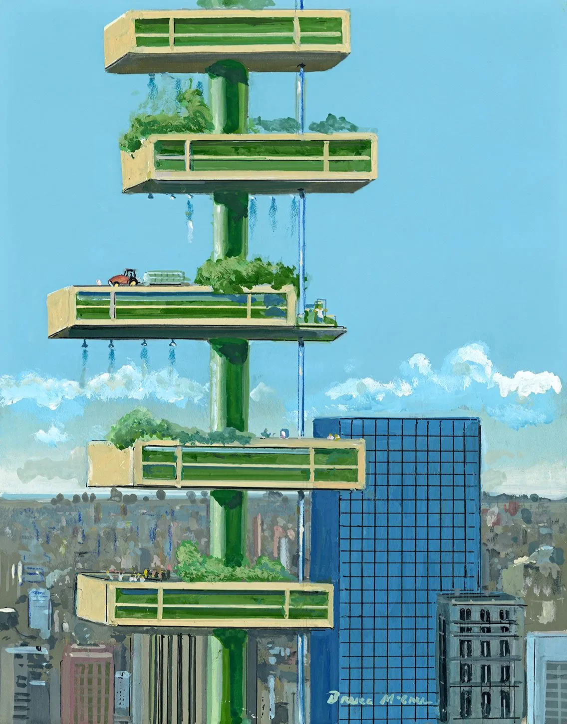
Plan and Implementation
Vertical farming has several models such as patio gardens built into old pallets to warehouses with stacked trays and greenhouses.
Hydroponic vertical farming technology allows growers to cultivate crops in stacked plat spots going up in tower like structures instead of going out saving on land and using less water.

Slide 6
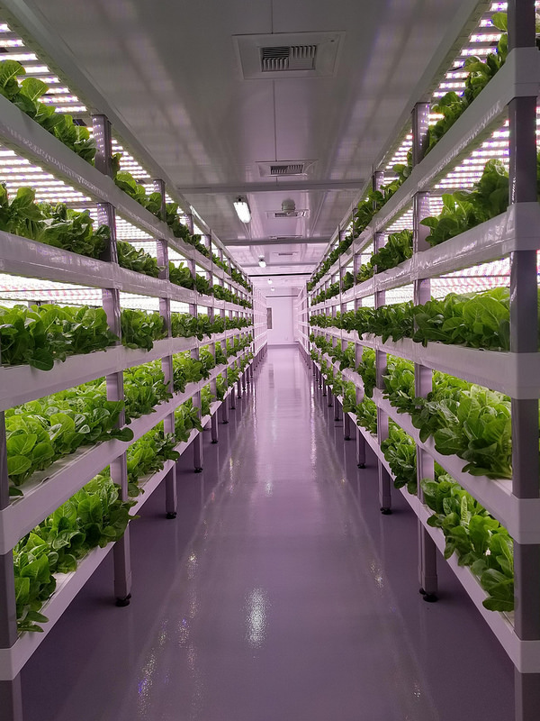
Pros
More food
modern technology,
food all year around
less water than normal farming
Control over growth and plants - no weeds or bugs
Notes:
The obvious benefit that comes from this is the amount of plants and more food that is able to grow in a single space. Vertical farming helped make certain angles and height possible for growing
With modern technology, we have made it possible for technology to mimic seen, rain, and other environmental conditions which help plants to undergo photosynthesis
The ability to grow food all year around, without weather changing the way plants grow
It considerably needs less water than normal farming
Control over growth and plants - no weeds or bugs

Slide 7
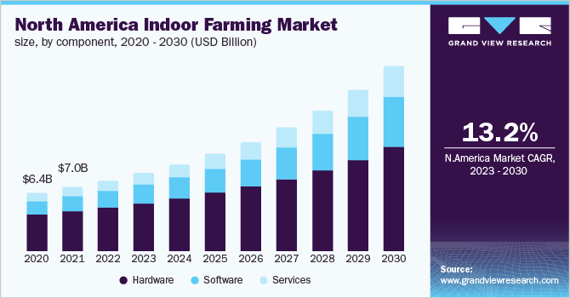
Cons
Experts needed
Cost
Manual pollination.
Notes:
Some of the downsides of vertical farming are that you need an expert to set up this farm, since it is very complicated.
Another downside is the investment cost, because of the complexity of the system they can be expensive and once you decide on a type of vertical farm it is hard to change.
Vertical farming relies on indoor, controlled environmental conditions. Under these conditions there are no bees, butterflies or other pollinators, meaning that farmers need to use manual pollination.

Slide 8
Summary
The world is constantly growing and making it harder to have plantation. This problem was solved with the idea of stacking plants and using technology to grow them in a healthy mimic of nature. This came a big help and plan that spread across the world. Coming with this solution came many pros but also cons. The big problem that comes with this is cost. These contain much technology and supplies which can be a big expense. Yet, we plan to make more Vertical Farms.

Slide 9
Summary
Regular farming became harder to do as land is used up with housing and office buildings. The solution to continue to farm without as much land was vertical farming. It is a farming style that instead of crops going outward they now grow upward. These are normally indoor witch allows you to grow crops year round, the biggest downside was that these are expensive to have because they are very complex systems. Overall I believe that vertical farming is good, the benefits outweigh the negatives and if I were a farmer I would definitely consider vertical farming instead of outward farming.

Slide 10
References
https://verticalfarmingplanet.com/the-full-history-of-vertical-farming-when-did-it-all-start/
What-is-vertical-farming
https://gustar.io/blog-en/disadvantages-of-vertical-farming/

